Slide 1
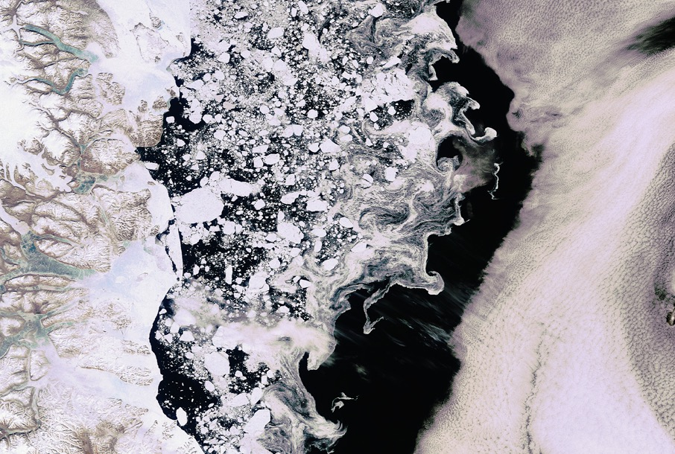


We aim at improving the quality of our Earth
by understanding the nature of its changes
Research and services provider enterprise in the Earth Observation Field

Slide 2
Sentinel-3
Sentinel-1
Sentinel-6

Slide 3
EO Applications & Services
EO data applications & Services
Glacier Monitoring
Bathymetry
Sea surface height anomaly
Hydrology and Agriculture
CryoSat+ Mountain Glaciers
BASE Platform
Globcurrent
Soil Moisture
Inland Water Level
Coastal Applications
Disaster Risk Reduction
Support to Legislation
Coastal Erosion
Floods and droughts
Plagues
Atmospheric Pollution
Climate Change

Slide 4
EO Applications & Services
EO data applications & Services
Glacier Monitoring
Bathymetry
Sea surface height anomaly
Hydrology and Agriculture
CryoSat+ Mountain Glaciers
BASE Platform
Globcurrent
Soil Moisture
Inland Water Level
Coastal Applications
Disaster Risk Reduction
Support to Legislation
Coastal Erosion
Floods and droughts
Plagues
Atmospheric Pollution
Climate Change

Slide 5
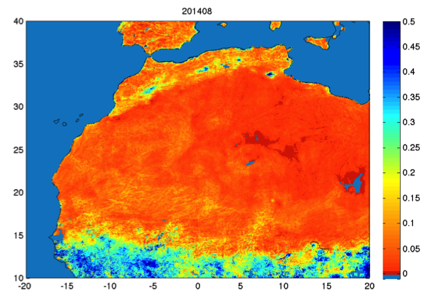
EO data applications & Services
Soil Moisture Continuous Data Service in Africa
Data | Soil moisture derived from L-band MW
Temporal Coverage | From 2010
Spatial Coverage | Global
Temporal resolution | Weekly
Spatial resolution | 1km
Delivery | WMS, FTP, direct download
SMOS satellite has resolution of 40km
isardSAT soil moisture downscaled with Optical and SAR at 1km and 500m
Introduction of SM increases resolution (1km)

Slide 6
EO data applications & Services
SMELLS
Soil Moisture for dEsert Locust earLy Survey
High resolution soil moisture is critically needed for the improvement of forecasts and early warning of a variety of plagues.
Used by the FAO in northern Africa, using our satellite-based soil moisture service to forecast where locust swarms will be.
smells.isardsat.com

Slide 7
MalarSAT

Slide 8
MalarSAT
The World Health Organization has designated Malaria as one of the major public health challenges undermining development in the world:
2 million people killed every year
500 million infected
40% of the world population is in risk of malaria at least 1 month per year.
Malaria is the leading cause of death among the under-five children in the world

Slide 9
MalarSAT
The ultimate aim of the Early Warning of Malaria Project is to provide malaria risk infection maps at global scale using Earth Observation data to support and prevent epidemic episodes.
The proposed service for creating malaria risk maps would be critically useful to improve the efficiency in insecticide programs, vaccine campaigns and the logistics epidemic treatment.
It has been shown that meteorological data is not sufficient to fulfil this objective.
The innovative and challenging part of the project is the use of EO data, meteorological data and AI to try and build indicators of malaria risk infection.

Slide 10
MalarSAT
The ultimate aim of the Early Warning of Malaria Project is to provide malaria risk infection maps at global scale using Earth Observation data to support and prevent epidemic episodes.
Mosquitoes mainly reproduce in new water puddles of very reduced dimensions (about 1 m. wide), created soon after rainfall, generally grouped.
Difficult to detect such small patches of water unless there are many of them spread in an area of several hundreds of meters.
Often spatial gaps of meteorological data to look at precipitation & humidity
Use EO to cover more ‘ground’, but what factors and which sensors to consider? How do we tie these all together?

Slide 11
MalarSAT
Main factors affecting Malaria outbreaks:
Temperature
Standing Water
Elevation
Water Quality
Land use
Buffer Zone

Slide 12
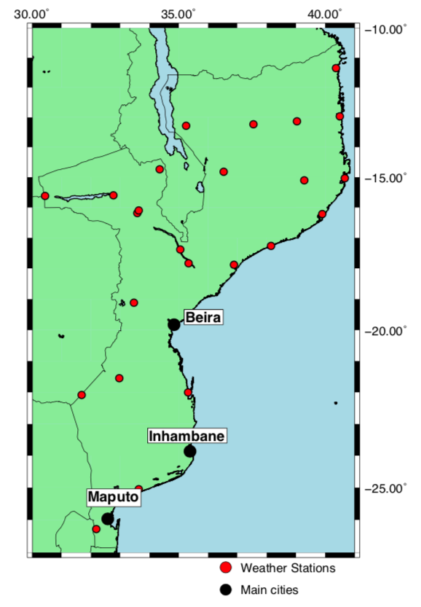
MalarSAT
Main factors affecting Malaria outbreaks:
Temperature
Ideal hatching water temperature: 24–30°C
Ideal evolution from hatching water temperature: 22 – 26 °C
Optimum air temperature for malaria-bearing mosquitoes: 25 – 30 °C, with min and max at 15 and 40 °C
EO to be used
MODIS/Terra Land Surface Temperature/ Emissivity Daily L3 Global 1km SIN Grid V006
MODIS data - NASA

Slide 13
MalarSAT
Main factors affecting Malaria outbreaks:
Standing Water
Water needs to be standing for 10-14 days for breeding, hatching and evolution
Frequency and amplitude of rainfall is an important factor
Must also consider evaporation rates & humidity
EO to be used
Detection of larger bodies of water
SMAP data - NASA
Sentinel 1 - ESA

Slide 14
MalarSAT
Main factors affecting Malaria outbreaks:
Standing Water
Water needs to be standing for 10-14 days for breeding, hatching and evolution
Frequency and amplitude of rainfall is an important factor
Must also consider evaporation rates & humidity
EO to be used
Detection of larger bodies of water
Soil Moisture as a proxy: SMAP Enhanced L3 Radiometer Global Daily 9 km
SMAP data - NASA

Slide 15
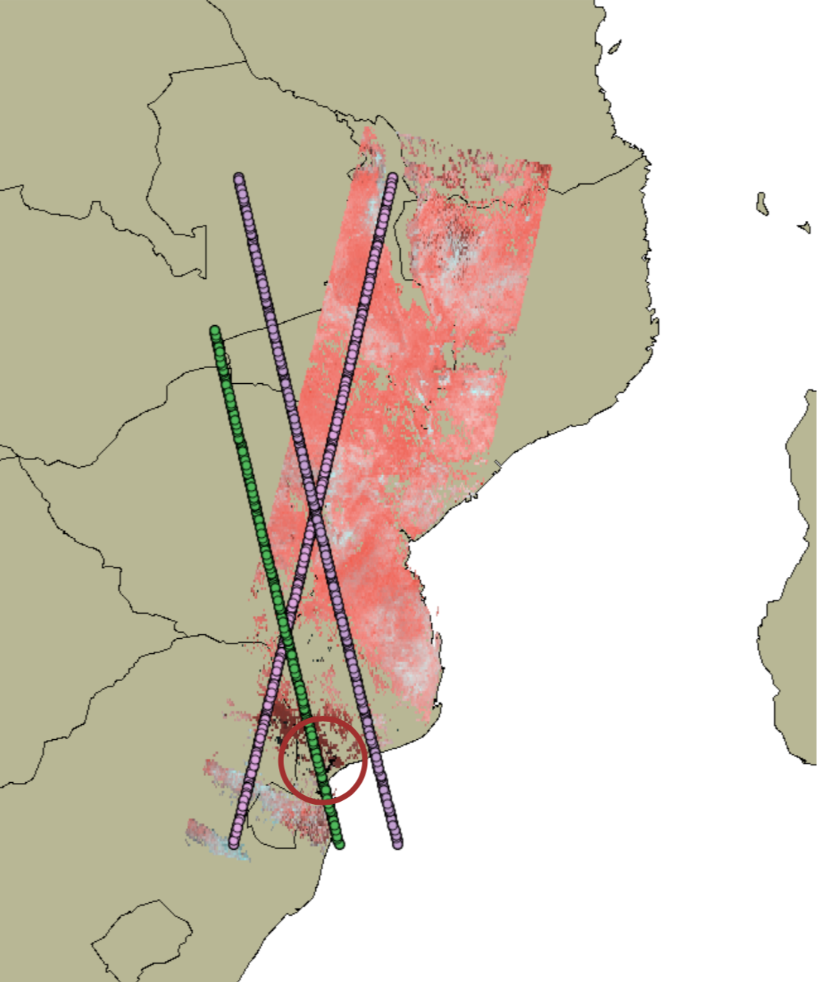
MalarSAT
Main factors affecting Malaria outbreaks:
Standing Water
Water needs to be standing for 10-14 days for breeding, hatching and evolution
Frequency and amplitude of rainfall is an important factor
Must also consider evaporation rates & humidity
EO to be used
Detection of larger bodies of water
Soil Moisture as a proxy: SMAP Enhanced L3 Radiometer Global Daily 9 km
Altimetry to detect water puddles
EnviSat Altimetry data - ESA

Slide 16
MalarSAT
Main factors affecting Malaria outbreaks:
Elevation
Malaria has a cut-off point of 1500m.
If it is above this very little chances of an outbreak
EO to be used
Satellite derived Digital Elevation Model (DEM), i.e. GTOPO30: Global 30 Arc-Second Elevation
DEM data -
Satellite derived

Slide 17
MalarSAT
Main factors affecting Malaria outbreaks:
Temperature
Standing Water
Elevation
Water Quality
Land use
Buffer Zone
Different species thrive different in various water quality states
Distance from possible zones of contamination (750m buffer zone)
Urban v/s rural
Land use data
Sentinel 1 - ESA

Slide 18
MalarSAT
Main factors affecting Malaria outbreaks:
Temperature
Standing Water
Elevation
EO data ✔️
EO data ✔️
EO data ✔️
Water Quality
Land use
Buffer Zone
Possibly EO data ️
EO data ✔️
Specific local EO
Different species thrive different in various water quality states
Distance from possible zones of contamination (750m buffer zone)
Urban v/s rural

Slide 19
MalarSAT
Main factors affecting Malaria outbreaks:
Temperature
Standing Water
Elevation
EO data ✔️
EO data ✔️
EO data ✔️
Water Quality
Land use
Buffer Zone
Possibly EO data ️
EO data ✔️
Specific local EO
Have data for these two factors, and have located several places of recent malaria outbreaks from newspaper clippings with reported number and approximate timelines

Slide 20
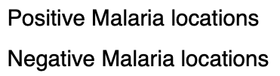
MalarSAT
South African Locations
Thabazimbi - POSITIVE
First reports, 14th March 2017, classified as low-risk area
Increase in heavy rains led to outbreak
By the 14th May, 1650 cases had been reported in the area
Closest weather station is 150km away

Slide 21
MalarSAT
South African Locations
Bushbuckridge - POSITIVE
First reports, 25th May 2017, classified as moderate-risk area
Increase in heavy rains, rise in temperature and humidity attributed to outbreak
665 cases reported in Bushbuckridge
Similar timing to first case

Slide 22
MalarSAT
South African Locations
Tzaneen - NEGATIVE
Proximity to Thabazimbi and Bushbuckridge
No reports of malaria outbreaks found in early 2017
Weather station shows there that there was rain
Part of moderate risked area for malaria

Slide 23
MalarSAT
Mozambique Locations
Inhambane - POSITIVE
First reports, 13th February 2019
300,000 cases reported in Inhambane province, including Inhambane city
22 people died in first 30 days of the year

Slide 24
MalarSAT
Mozambique Locations
Nhamatanda - POSITIVE
Cyclone Idai hit area on 15th March 2019
First reports of malaria reported on 27th March 2019
22nd April 2019, report stating 14,900 cases in area
6,125 of these cases in Nhamatanda
Closest weather station in Beira, 100km away

Slide 25
MalarSAT
Mozambique Locations
Chimoio - NEGATIVE
Evidence of wet conditions similar to two previous cases
Part of endemic malaria zone for Mozambique
No reports of Malaria in region in early 2019

Slide 26
MalarSAT
Kenya Locations
Kagir Village - POSITIVE
First reports of malaria outbreak 9th February 2018
Tens of cases reported, including deaths in Kagir
23rd April 2018 – report saying hundreds of people had been hospitalized
Closest weather station – Eldoret, 180km away

Slide 27
MalarSAT
Kenya Locations
Nakuru - NEGATIVE
Spatially close to Kagir village
Had precipitation at similar to time to outbreak in Kagir
Falls in high risk Malaria zone for Kenya, but no related outbreaks in Early 2018

Slide 28
MalarSAT
Temperature data
Soil Moisture data
How to use and combine this data for a tangible use?

Slide 29
MalarSAT
BACK UP SLIDES

Slide 30
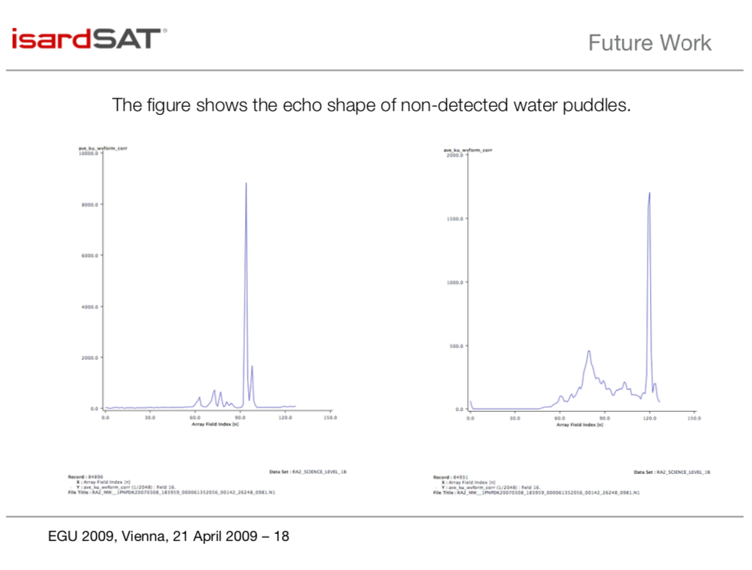
MalarSAT

Slide 31
MalarSAT
Satellite | Mission | Revisit Time | Resolution
Sentinel 1 ESA | Radar imaging mission for land and ocean services | 12 days | 5-10m
Sentinel 2 ESA | Multispectral high-resolution imaging mission for imagery of vegetation, soil and water cover, inland waterways and coastal areas | 5 days | 10-60m
Sentinel 3 ESA | Multi-instrument mission to measure sea-surface topography, sea- and land-surface temperature, ocean colour and land colour | ~2 days | Instrument dependent
SMOS ESA | Soil Moisture and Ocean Salinity | ~3 days | 40km
SMAP NASA | Soil Moisture Active Passive | ~3 days | 9km
MODIS NASA | Moderate Resolution Imaging Spectroradiometer | 1-2 days | 250m-1km

